Slide 1


Predicting Churn for Bank Customers
Bhargava Gaggainpali
DSC680 - Applied Data Science
bgaggainpali/bgaggainpali_DSC680 · GitHub

Slide 2
Business problem & Hypothesis
In financial industry, banks are playing important role in challenging times like now, with COVID pandemic across the globe. People are losing jobs and financial institutions are facing more Customer churn in Bank Accounts. The increase in Customer Churn rate will result in significant financial loss to commercial banks. It is very critical for lending institutions like banks to have a prediction model to be able to predict customers churn to better serve the customers and reduce the churn.
I have selected the topic, as I was interested in knowing the variables which influence the Bank Account Customer Churn key factors. As I explore more about the domain, I understand that it’s not same set of rules which is being used across domain and each different banks and credit unions are based on different features and calculations when predicting the churn and the factors which influence them.

Slide 3
Solution Method
I see this problem as a classification issue, where we should try to understand and able to predict the customers, who have high Bank Customer Churn chances.
Planning to use supervised machine learning algorithm to work on the classification problem to be trained with algorithms like:
1. Logistic Regression
2. Decision Tree
3. Random Forest
Start with loading data into a data frame and then understand the data, then perform Exploratory Data Analysis (EDA) on the data set. EDA involves doing Univariate and Bivariate Analysis, identify missing values and outliers and fill the gaps with appropriate values. In the next step, building model with starting from logistic regression and observe the accuracy of the model. When the accuracy of the of the model is not high, then planning to use Decision Tree and Random Forest to achieve higher accuracy.

Slide 4
Data
Data is sourced from Kaggle, which has all the required variables for prediction.
https://www.kaggle.com/adammaus/predicting-churn-for-bank-customers?select=Churn_Modelling.csv
Variable Description
RowNumber Sequence Number
CustomerId Customer Account Number
Surname Customer Name
CreditScore Credit Score
Geography Location Country
Gender Male / Female
Age Customer Age
Tenure Period of time in Years as Customer to the Bank
Balance Balance amount in the Bank
NumOfProducts Number of Products availed by the Customer
HasCrCard Customer has Credit card
IsActiveMember Customer Active Member
EstimatedSalary Customer Salary
Exited Customer Churn value

Slide 5
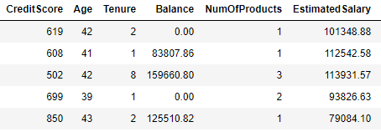
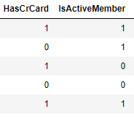
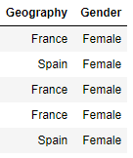
Exploring Data 1
Read first few lines of the data to observe the data variables.

Slide 6
Exploring Data 2
Categorical Features: Based on the data, below are categorical variables.
Geography
Gender
Exited 1 = Exited, 0 = Not Exited
Ordinal Features: Based on the data with inherent hierarchy, below are ordinal variables.
HasCrCard
IsActiveMember
Numerical Features: Based on the numerical data, below are numerical variables.
CreditScore
Age
Tenure
Balance
NumOfProducts
EstimatedSalary

Slide 7
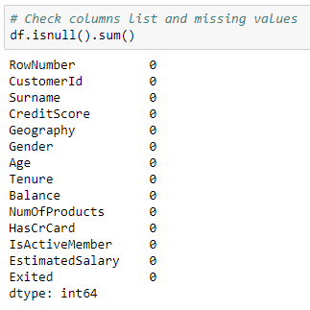
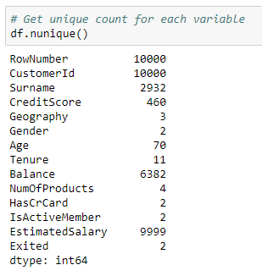
Exploring Data 3
Retrieve the stats of the data to observe the null values and unique count including the target variable.

Slide 8
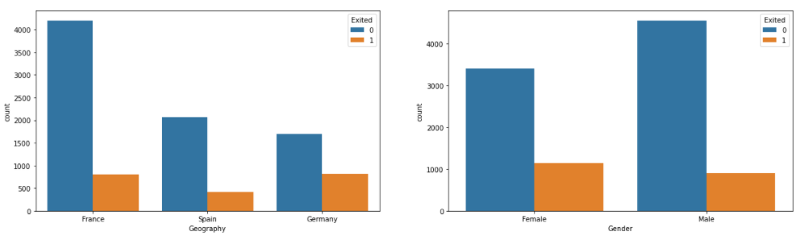
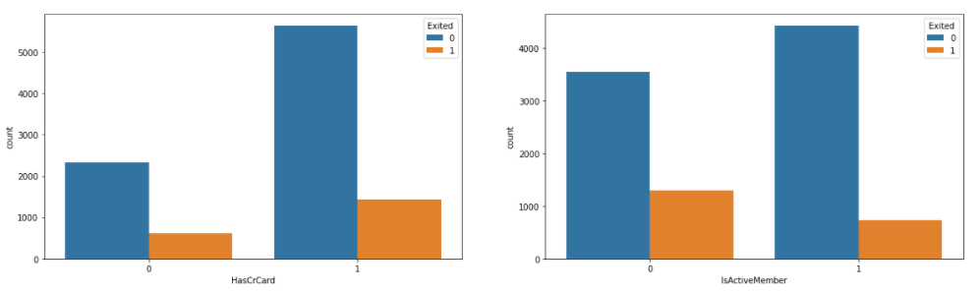
Plots 1

Slide 9
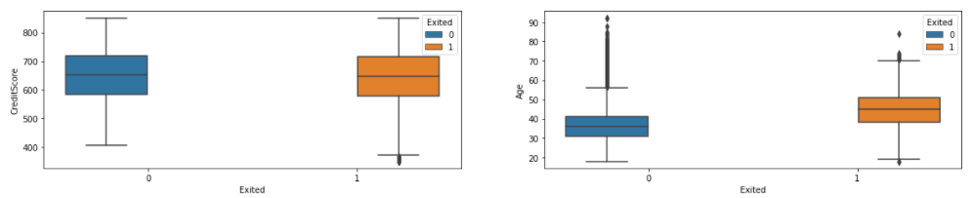
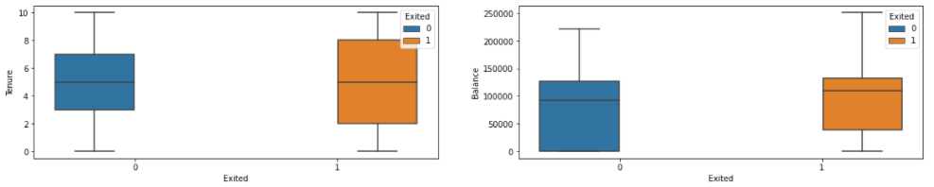
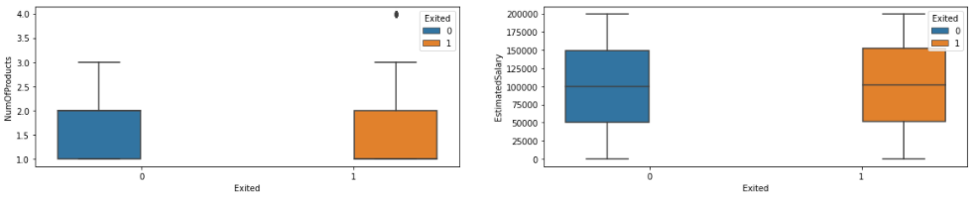
Plots 2

Slide 10
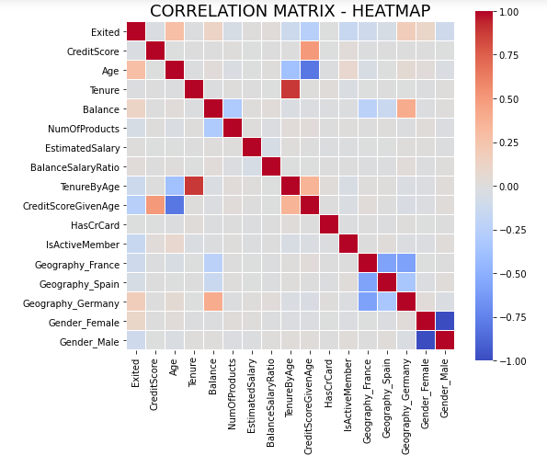
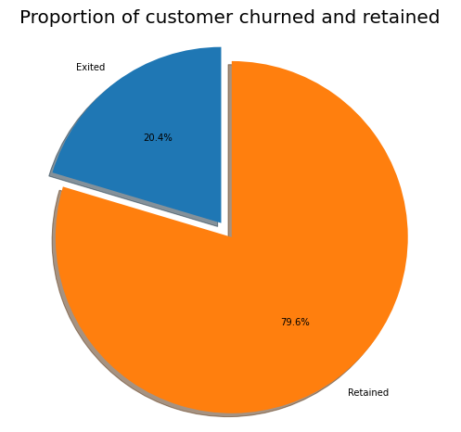
Plots 3
Built Correlation Heatmap and target variable Pie Plot.

Slide 11
Observations
Majority of the data is from persons from France. However, the proportion of churned customers is with inversely related to the population of customers alluding to the bank.
The proportion of female customers churning is also greater than that of male customers
Majority of the customers that churned are those with credit cards.
Inactive members have a greater churn.
There is no significant difference in the credit score distribution between retained and churned customers.
The older customers are churning at more than the younger ones alluding to a difference in service preference in the age categories.
With regard to the tenure, the clients on either extreme end (spent little time with the bank or a lot of time with the bank) are more likely to churn compared to those that are of average tenure.
Bank is losing customers with significant bank balances which is likely to hit their available capital for lending.
Neither the product nor the salary has a significant effect on the likelihood to churn.

Slide 12
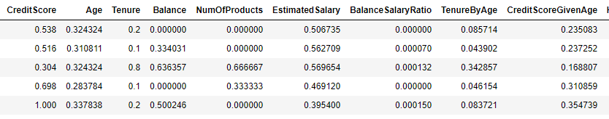
Scaling the Numeric Data
Applied MinMax Scaler to scale the numeric data variables.

Slide 13
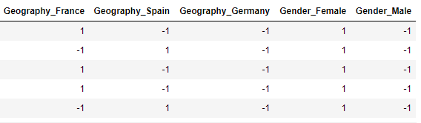
Categorical Data to Numeric
Applied One Hot Encoding to convert Categorical data to Numerical data variables.

Slide 14
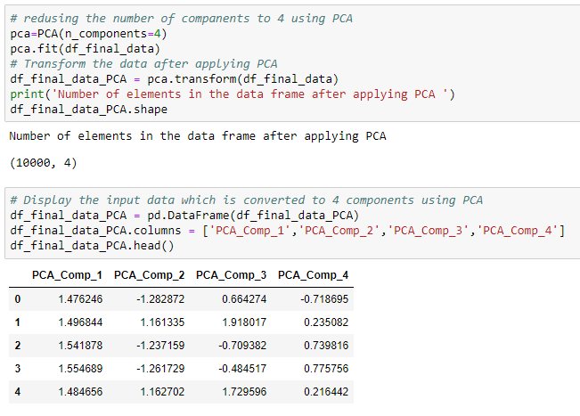
Dimensionality Reduction
Applied PCA to reduce the number of Dimensions or Variables.

Slide 15
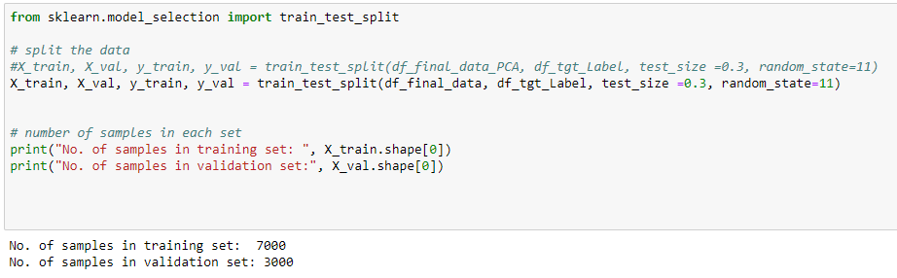
Separate Train and Test Data
Split the available data in the ratio of 70:30 for training and testing the model. Also making sure to have both Churn and Not Churn data in both training and testing data sets.

Slide 16
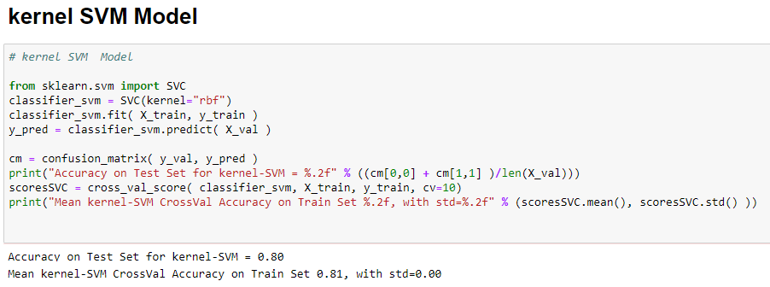
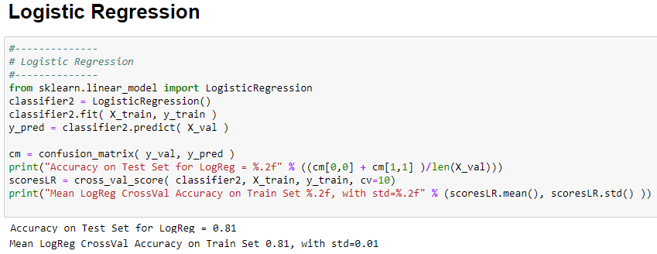
Predictive Models
Predictive models build are built using ‘SVM’ & ‘Logistic Regression’.

Slide 17
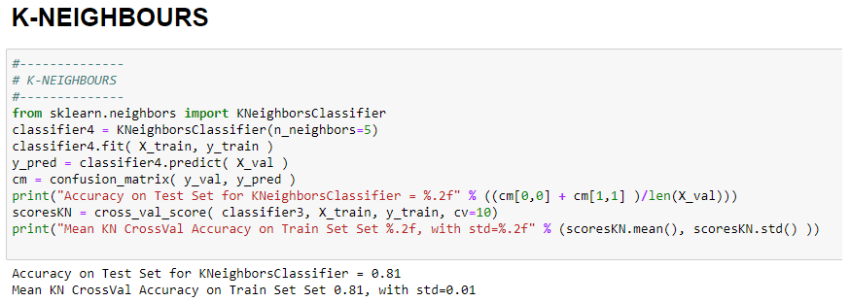
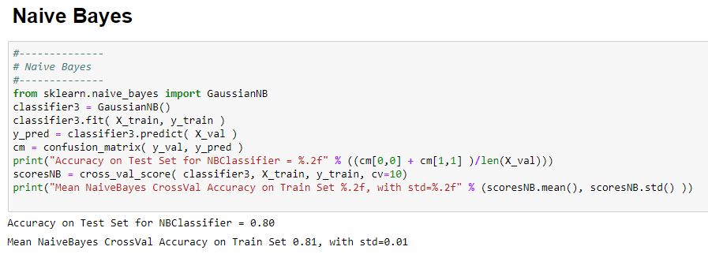
Predictive Models
Predictive models build are built using ‘KNeighborsClassifier’ & ‘Naïve Bayes’.

Slide 18
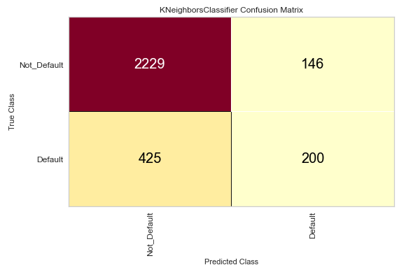
Confusion Matrix
Chart shows the good Value in the ‘True Positive’ and ‘False Negative’ compared to ‘False Positive’ and ‘True Negative’ indicates that model is performing as expected.

Slide 19
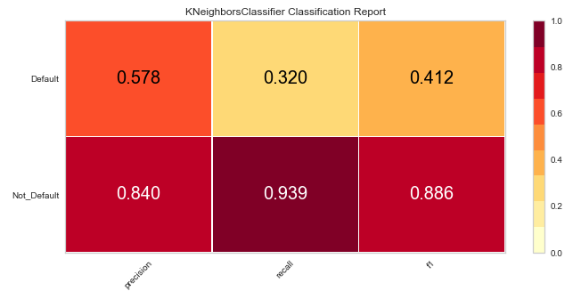
Classification Report
Chart shows the good precision and recall values and f1score 0.886 for non-exited customers indicates that model is performing as expected.

Slide 20
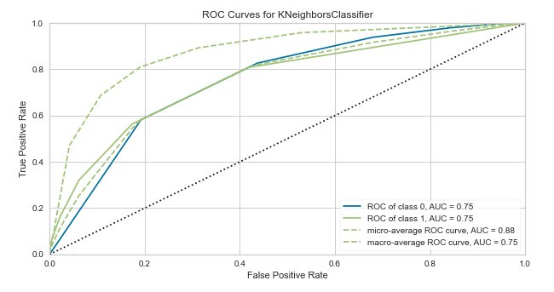
ROC Curve
Chart shows the AUC (Area Under Curve) is at a value of 0.75 indicates that model is performing as expected.

Slide 21
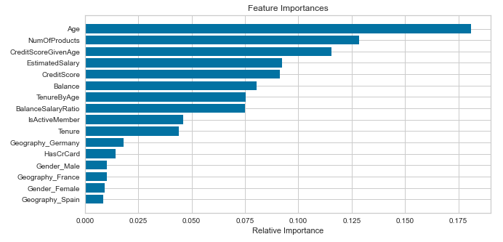
Feature Importance
Given chart shows that Age and Number of Products are most important factors in deciding the Bank Customer Churn followed by Credit Score and Estimated Salary.

Slide 22
Future Analysis Questions
I would like to continue my analysis and try to explore further to find answers to the given questions.
With the COVID situation in place, are these features still valid to predict the Bank Customer Churn.
As with the different type of Churns like Telecom Customer Churn, Credit Card Customer Churn, would these features stay in common across industry.
Will the feature importance change with respect to geographic location?

Slide 23
Reference
1. Soumya Sethuraman 2019 - Why Customers Leave & What Can Banks Do?
Why Customers Leave & What Can Banks Do? | Tiger Analytics
2. Sina Esmaeilpour Charandabi - Kent State University - 2020 - Prediction of Customer Churn in Banking Industry
(PDF) Prediction of Customer Churn in Banking Industry (researchgate.net)
3. Abbas Keramati, Hajar Ghaneei & Seyed Mohammad Mirmohammadi – 2016 -
Developing a prediction model for customer churn from electronic banking services using data mining
https://jfin-swufe.springeropen.com/articles/10.1186/s40854-016-0029-6
4. Diana Kaemingk - August 29, 2018 - Reducing customer churn for banks and financial institutions
Reducing customer churn for banks and financial institutions // Qualtrics
5. Nelson Belém da Costa Rosa - November 2018 - Gauging and Foreseeing Customer Churn in the Banking Industry
TGI0223.pdf (unl.pt)

